Slide 1
RevUStg BILLARDTECH - GROUP 106
Introduction to Software Engineering

Slide 2
ABOUT RevUStsg
Create a user-friendly website for renting and selling game accounts from platforms like Steam and Epic Games at lower prices. Users can save on retail costs while account owners can monetize their progress. The platform ensures secure transactions and account verification, fostering a trusted gaming community.

Slide 3
PROBLEM STATEMENT
The problem of | Buying games, apps through Steam, Epic Games, … takes many steps and taxes are included in the price
Affects | Gamers, App users, Publishers
The impact of which is | Make the user not able to purchase for the software
A successful solution would be | Giving a simpler way to rent, purchase game accounts without taxes or complex procedures by using local internet banking or even phone card

Slide 4
PRODUCT POSITION STATEMENT
For | App user
Who | People that want to purchase apps and games but don’t have a international mastercard
The RevUStG | is a website
That | enable renting, purchasing games/apps with local internet banking or phone card
Unlike | Steam, Epic Games or some other platforms that only sell but not allow to rent account
Our product | Users can buy game accounts much simpler and faster with easier way to purchase

Slide 5

PROJECT MANAGEMENT

Slide 6
TEAM STRUCTURE
LE TRAN HOANG PHUC
Project Manager Developer
LE NGUYEN PHUONG NAM
PHAM PHUC LOC
VO DANG HUY
MAC LE DUC MINH
Developer
Developer
Designer
Tester

Slide 7
TEAM MEMBERS AND ROLES
21127136
Lê Trần Hoàng Phúc
21127062
Võ Đăng Huy
Project manager, Architecture
Designer, Tester
21127526
Mạc Lê Đức Minh
21127100
Phạm Phúc Lộc
Developer ,Tester
Developer ,Tester
21127647
Lê Nguyễn Phương Nam
Developer ,Tester

Slide 8
SOFTWARE REQUIREMENTS

Slide 9
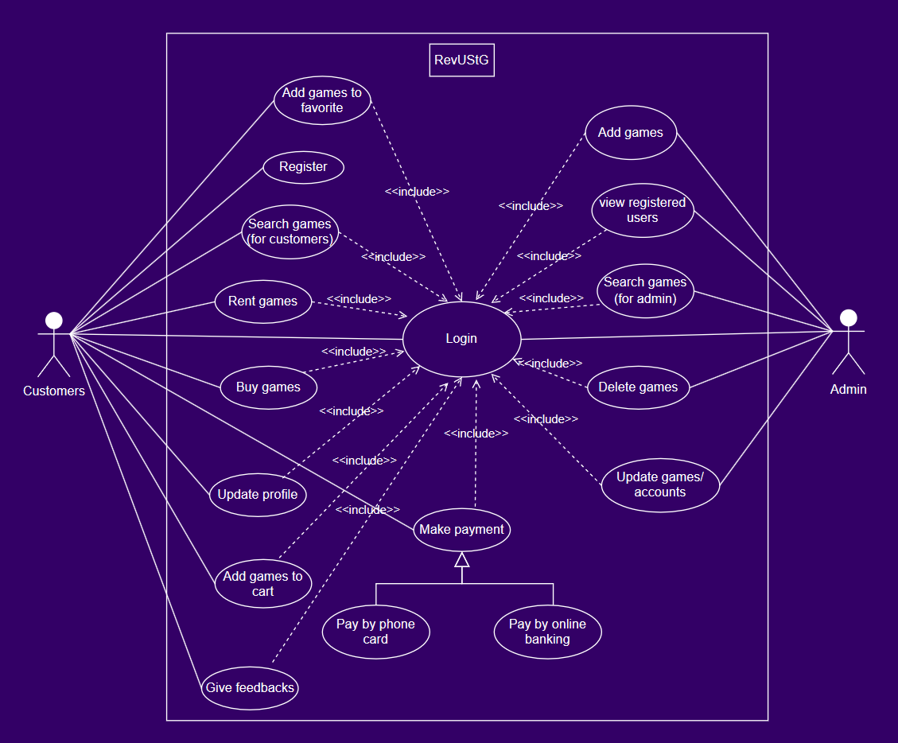
USE-CASE MODEL

Slide 10
NON-FUNCTIONAL REQUIREMENTS
No. | Feature | Description | Priority
001 | Login security | Disable user’s account for 5 minute if entered wrong 3 times | High
002 | Availability | Available to use 24/7 | Medium
003 | Supportability | Work on Windows 10, 11 | Medium
004 | Compatibility | Work on common browsers like Chrome, Microsoft Edge,.. | High
005 | Maintenance and Scalability | Easy to maintain and upgrade without causing disruptions to user activity | High
006 | Requirements | There must be internet for users to use the web | High
007 | Reliability | Stable and free from frequent errors during regular usage | High
008 | Usability | The UI should be user-friendly, easy to understand and follow | Medium

Slide 11
ANALYSIS AND DESIGN

Slide 12
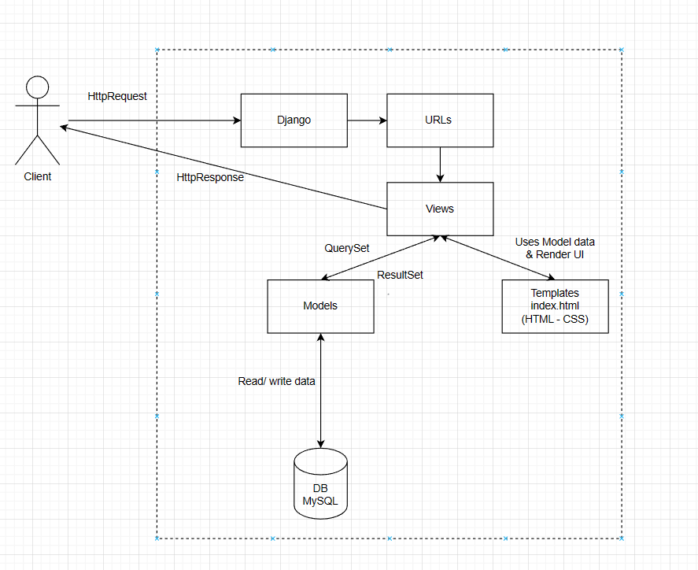
ARCHITECTURE
Using MTV pattern
Models: acts as the interface of the data. It’s responsible for maintaining data, such as fields, relationships, validations, behaviors of data. With Django framework for implementation, we can create models in models.py - a file created automatically by Django with default SQLite database
Views: the components that handle the requests from the users and decide what data to display, perform data's logic before giving it to template. All the views are defined and implement in views.py
Templates: the component that specifies the structure of the output. Including all the HTML files that use the data given by Views

Slide 13
SOFTWARE TESTING

Slide 14
TEST ENVIROMENT
Processor
Disk space
Memory
Display resolution
Hardware requirement
Core i3 or equivalent
Optional
1 GB minimum, 2 GB recommended
1440 x 900 px, 1920x1080 px recommended

Slide 15
TEST ENVIROMENT
VSCODE
Windows 10, 64 bits
MySQL
Windows 11, 64 bits
Software in the Test Environment
IDE- Code editor
Verify compatibility – Operating system
Verify Database
Verify compatibility – Operating system

Slide 16
TEST PLAN
Functionality Testing:
Login as End User
Register as End User
Payment with Phone Card
Payment with Bank Account
Purchase for Product in Cart
Search for Product
Add to Cart

Slide 17
TEST PLAN
Role | Minimum Resources Recommended | Specific Responsibilities or Comments
Test Manager | Lê Trần Hoàng Phúc | Provides management oversight. Responsibilities include: planning and logistics agree mission identify motivators acquire appropriate resources present management reporting advocate the interests of test evaluate effectiveness of test effort
Tester | Võ Đăng Huy Phạm Phúc Lộc Lê Nguyễn Phương Nam Lê Trần Hoàng Phúc Mạc Lê Đức Minh | Implements and executes the tests. Responsibilities include: implement tests and test suites execute test suites log results analyze and recover from test failures document incidents

Slide 18
TEST PLAN
Role | Minimum Resources Recommended | Specific Responsibilities or Comments
Test System Administrator | Mạc Lê Đức Minh | Ensures test environment and assets are managed and maintained. Responsibilities include: administer test management system install and support access to, and recovery of, test environment configurations and test labs

Slide 19
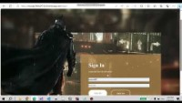
TEST RESULT - DEMO
HERE IS OUR DEMO VIDEO
THANKS FOR WATCHING!

